Slide 1





SUPERVISED LEARNING REGRESSION
WORLD WIDE UNIVERSITIES PREDICTION
Dec 9 , 2021
9:30 a.m.
Bushra AlOlit,Laila Almjnuni
Dr.Mejdal ALQahtani
Knowing features effect

Slide 2


OUTLAINE
01
Introduction
02
Data
03
Model Selection
04
Conclusion Q&A

Slide 3


INTRODUCTION
Based on the most important place & environments of study, knowledge, experience which is Universities we decide to identify and predict on it to create a model that predict best universities

Slide 4
Tools
1st
2nd
Pandas and Numpy
Selenium
4th
03
3rd
Python, Seaborn and Matplotlib
Sklearn
5th
Jupyter

Slide 5


DATA
(web-scrapping)
1. topuniversities.com
2. Selenium
3. 1000+ Universities
Pickle

Slide 6



DATA
(EDA)
Remove Unnecessary data
Set index
Missing Value
Visualization

Slide 7
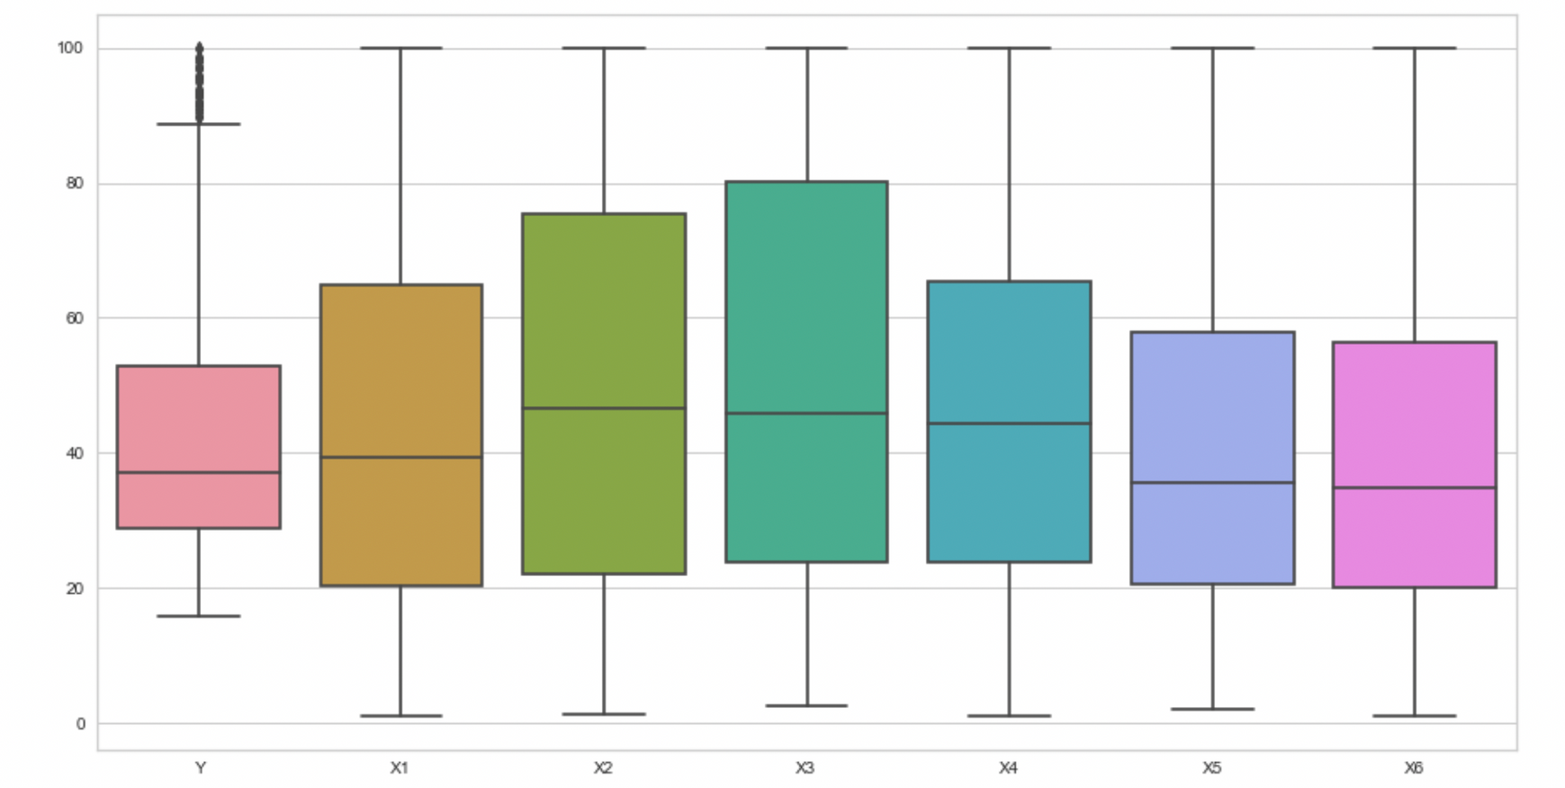
Data
(Boxplot)

Slide 8
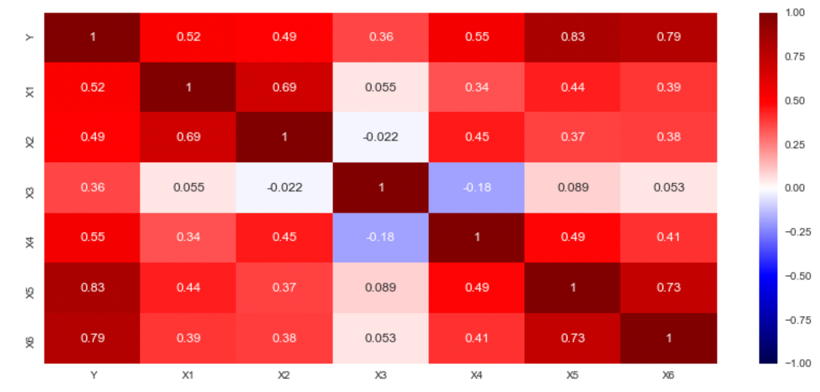
Data
(Correlation)

Slide 9
Cross-Validation
Date: Dec 1, 2021
Time: 10:00 AM
Model Selection Regression
Regression Model
R2
Linear Regression
0.861
Polynomial
0.898
0.888
Random Forest
0.867
Ridge
0.867
Lasso
0.861
Elastic Net

Slide 10
Cross-Validation
Date: Dec 1, 2021
Time: 10:00 AM
Model Selection Regression
Regression Model
R2
Linear Regression
0.861
Polynomial
0.898
0.888
Random Forest
0.867
Ridge
0.867
Lasso
0.861
Elastic Net

Slide 11
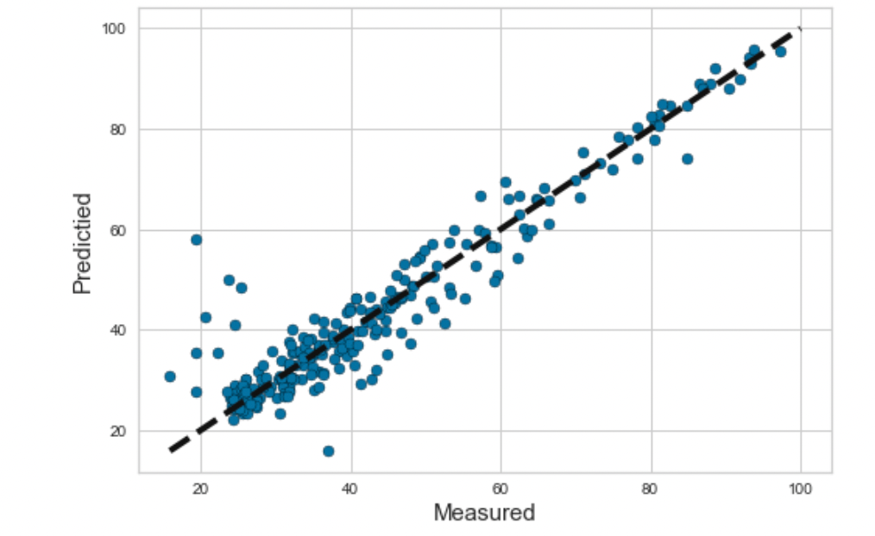
Model Selection
(Visualization Polynomial Regression)

Slide 12
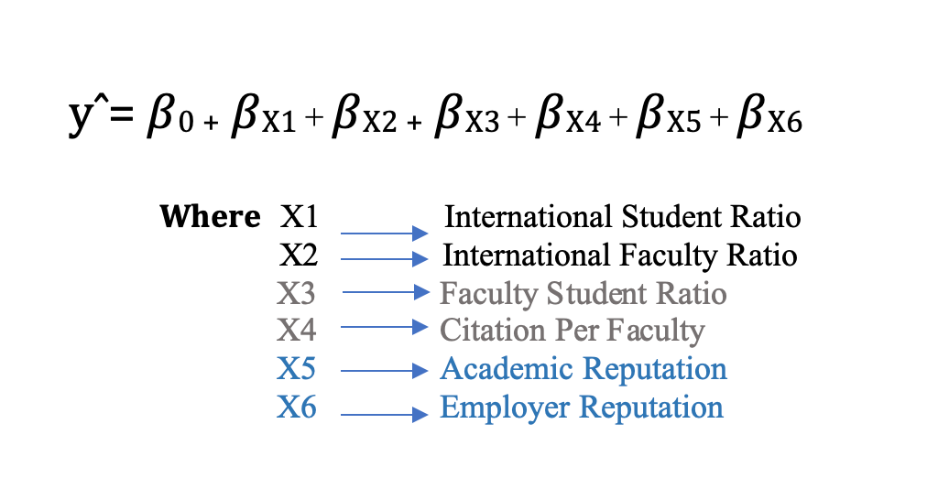
Coefficient of Polynomial Regression model Prediction

Slide 13
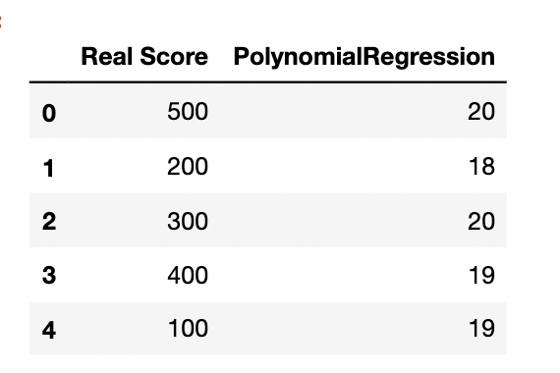
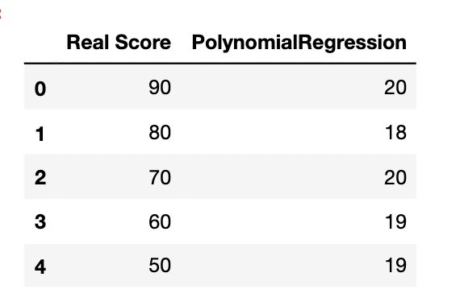
Example Prediction
Final Coefficient of polynomial prediction is
equal to 18.74

Slide 14
Conclusion
Main data was web scraped
Boxplot was used to define outlier
Polynomial model is the best fit
The use of python to find correlation between numerical feature

